Slide 1
Cargo Tracing and Business Analysis
Group Id – 23
Guide- Prof Kiran Kumari
Members-
1514068 – Saurabh Baj
1514074 – Niyati Daftary
1514080 – Jayesh Gaur
1514085 – Aditya Jawalikar

Slide 2
Problem Definition
Due to globalization, the industries are achieving business growth in no matter of time. The sellers are producing goods in one country and selling the same in other country, thus by making huge profits. The existing system was inefficient due to use of barcode.
Cargo Tracing and Business analysis is a proposed system which will help the sellers to trace their goods while also giving the business analysis to them to help them in important business policies.

Slide 3
Overview Of Implementation
Literature Survey.
Requirement Gathering and dataset research .
Research of Algorithm to be used and choosing the better one.
SRS Documentation.
SDD Documentation along with Rough Designing of User Interface of web portal.

Slide 4
Overview Of Implementation
Database tables formulation along with the documentations.
SPMP documentation along with the Risk Identification.
STD documentation along with the Web Portal Designing.
An android Application for the system has been proposed by implemented the User Interface.

Slide 5
Software Requirement Specification
Functional Requirements identified for our system are as below-
Registration
Login
Tracing
Booking of Shipment
RFID Scanning
Business Analysis-(Maximizing profits based on user given attribute)
The Non- Functional Requirements identified for the system are-
Reliability
Availability
Usability
Security
Integrity
Document Link- srs.pdf

Slide 6
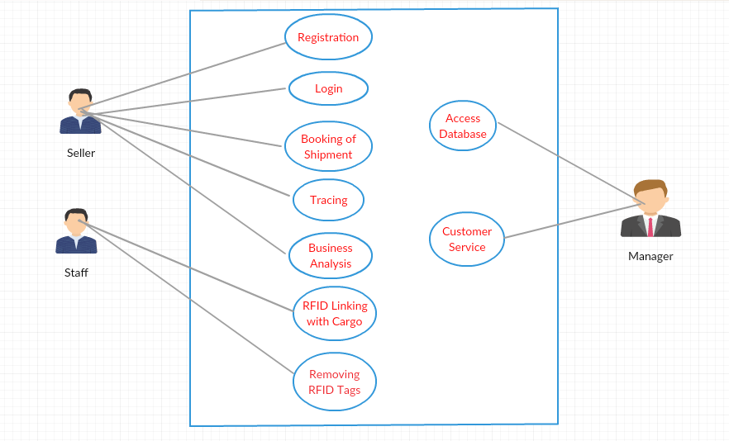
Software Design
These are the following software documents developed for the proposed system. SDD Link - sdd.pdf
Use Case Diagram-

Slide 7
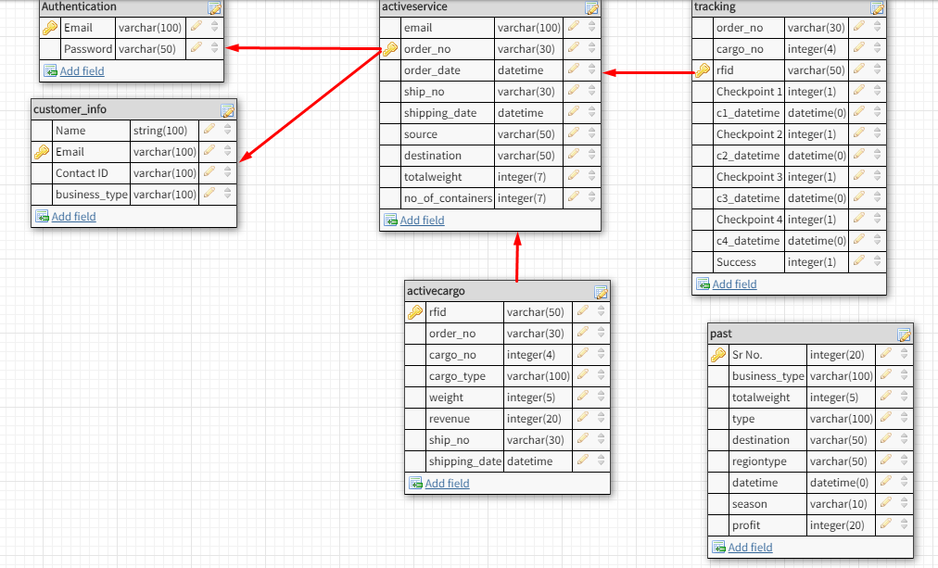
Software Design
These are the following software documents developed for the proposed system.
Database Schema Diagram-

Slide 8
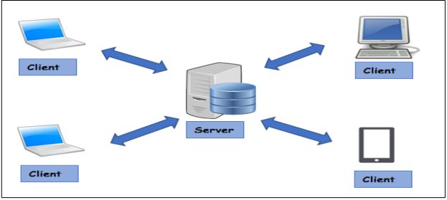
Software Design
Architecture-

Slide 9
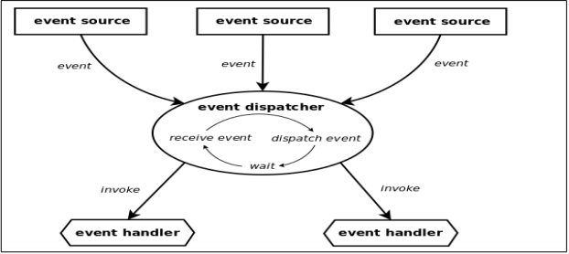
Software Design
Architecture-

Slide 10
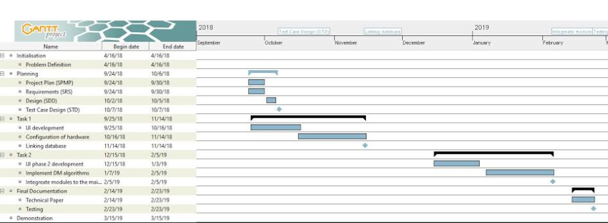
Software Project Management Plan
SPMP Link- spmp.pdf
Time Line Chart-

Slide 11
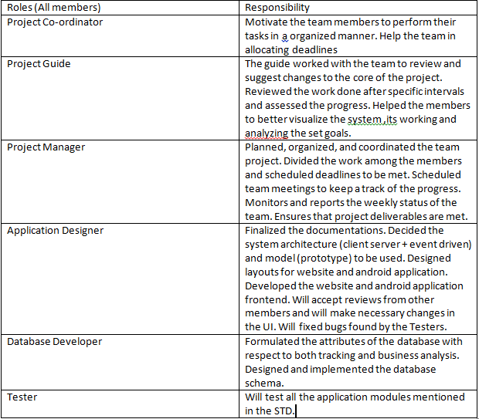
Software Project Management Plan
Roles and Responsibilities-

Slide 12
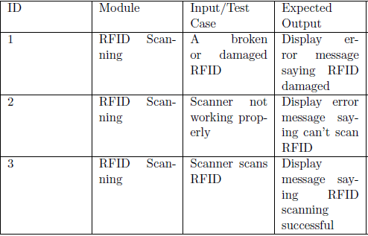
Test Cases
STD Link - std.pdf
We have developed many test cases. Some of them are shown below-

Slide 13
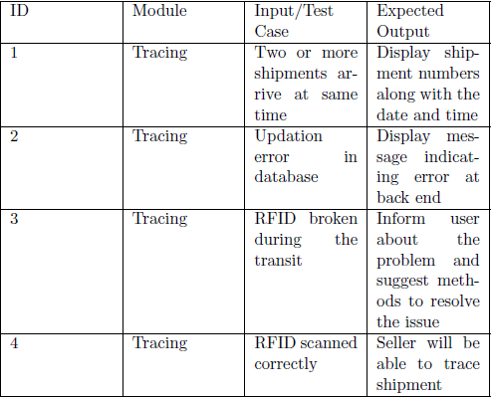
Test Cases

Slide 14
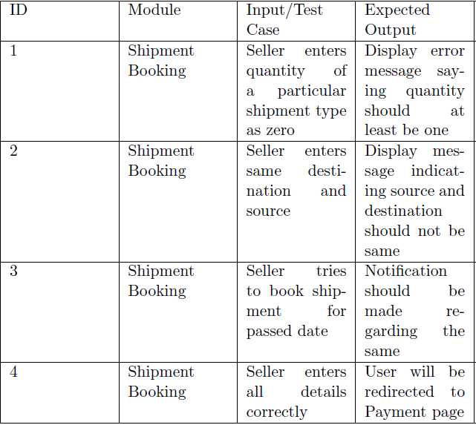
Test Cases

Slide 15


